Slide 1

The revolution of electric vehicle
Big Data Technology - Final Project
Professor: Mrudula Mukadam
Team:
Ba Luan Tran
Emelyne Kwizera
Trong Hoang

Slide 2
Agenda
Overview
Kafka and Spark Streaming
Hive and Spark SQL
Visualization with Tableau
Demonstration

Slide 3
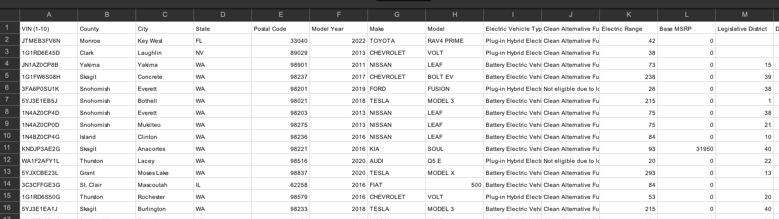
Overview > Dataset
This dataset shows the Battery Electric Vehicles (BEVs) and Plug-in Hybrid Electric Vehicles
(PHEVs) that are currently registered through Washington State Department of Licensing (DOL).
Dataset size: 112634 rows
https://data.wa.gov/Demographics/Electric-Vehicles-by-Manufacturer/958t-wifj
CSV dataset
Notes:
Trong

Slide 4
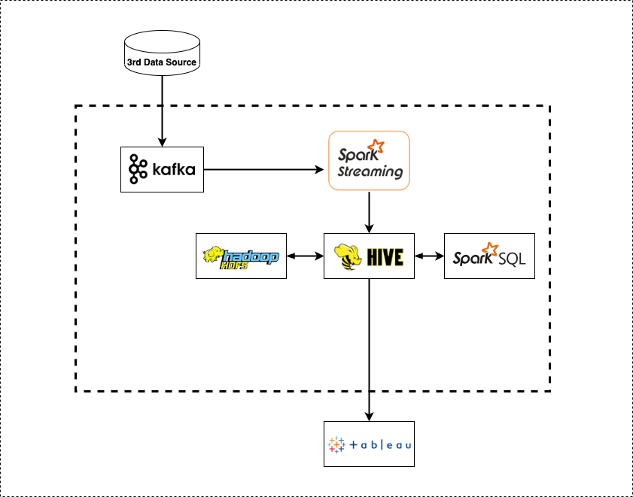
Overview > Dataflow

Slide 5
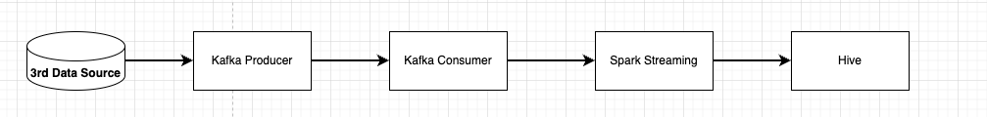
Kafka and Spark Streaming
Why Kafka?
A distributed streaming platform
Publish and subscribe to a stream of records
Fault-tolerant
Process records as they occur in the stream
Workflow
We simulate the real-time processing by reading the CSV line by line and feed to Kafka Producer
Kafka Consumer will receive it and use Spark Streaming to insert data into Hive

Slide 6
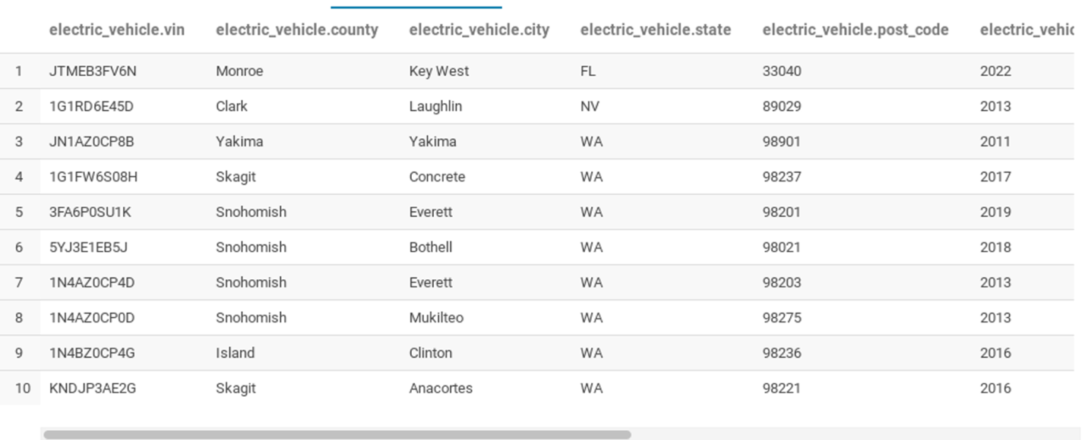
Hive And Spark SQL
Why Hive?
Structured data
Enable to write SQL
Designed for OLAP
Hive table
We want to find some interesting information from the data:
The growth of EV in each year
Number of EV model each year
How many Plug-in Hybrid Electric Vehicles (PHEV), vs Battery Electric Vehicle (BEV)
Use Spark SQL to query the data from Hive tables
Save the result into Hive as tables
We can use that result tables to visualize
Notes:
framework on top of spark engine that uses queries to manipurate dataset
types of dataset you can connect to: you can load
structured dataset: tables(csv, Hive)
semi- structured dataset: Json, Parquet

Slide 7
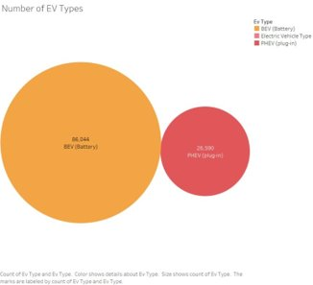
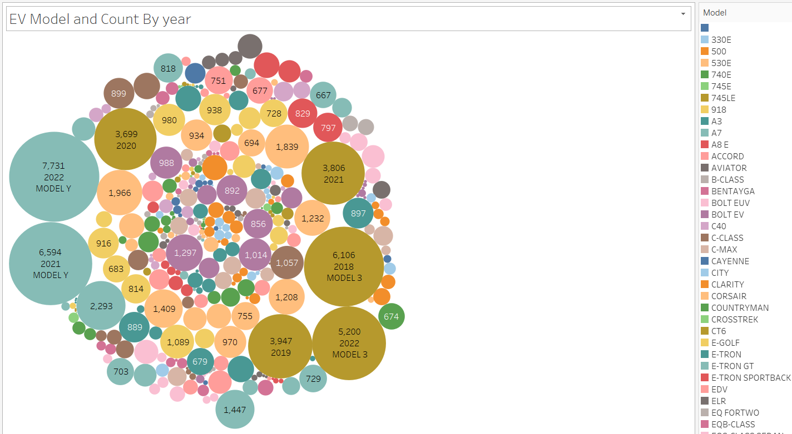
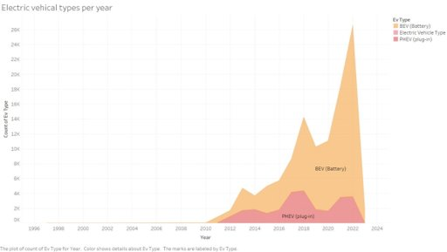
Visualization with Tableau
Tableau is a visual analytics platform, used for reporting and analyzing vast volumes of data.
It helps to create different charts, graphs, maps, dashboards, and stories for visualizing
It can connect to several data sources
Simple, no prior programming knowledge is needed

Slide 8
Demonstration

Slide 9
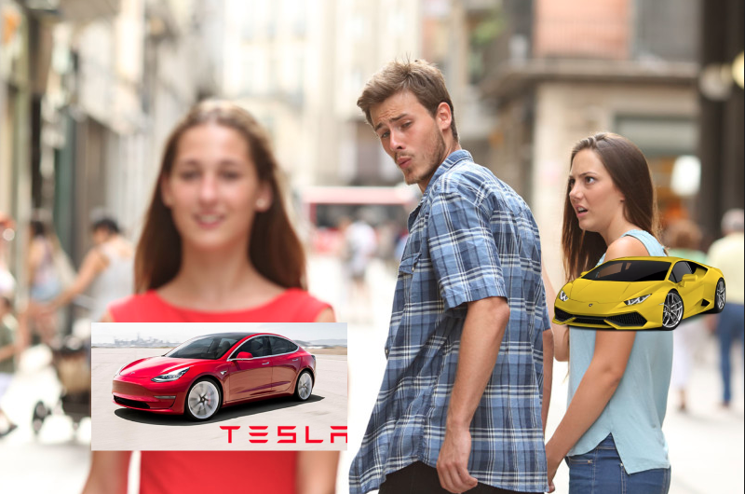

Now you can see how much
electric vehicle growth in
recent years.
Interesting data, right?

Slide 10
Thank you for listening

